Slide 1

Avocados
Vs.
Millennials
Group 5
Adrian Lupercio
Jeremy Kalmus
Laura Gutierrez
Notes:
Laura

Slide 2

Does the Millennial population affect the price of avocados?
Brief Summary
Collected data
Cleaned data
Manipulated and merged data for better results
Created charts and tables to represent this data
Analyzed the result
Notes:
Laura

Slide 3






Questions
Data
Does the millennial population percentage affect the price of avocados?
Does the average household income affect the price of avocados?
Does the weather affect the price of avocados?
Types -
Sources -
Notes:
Adrian

Slide 4
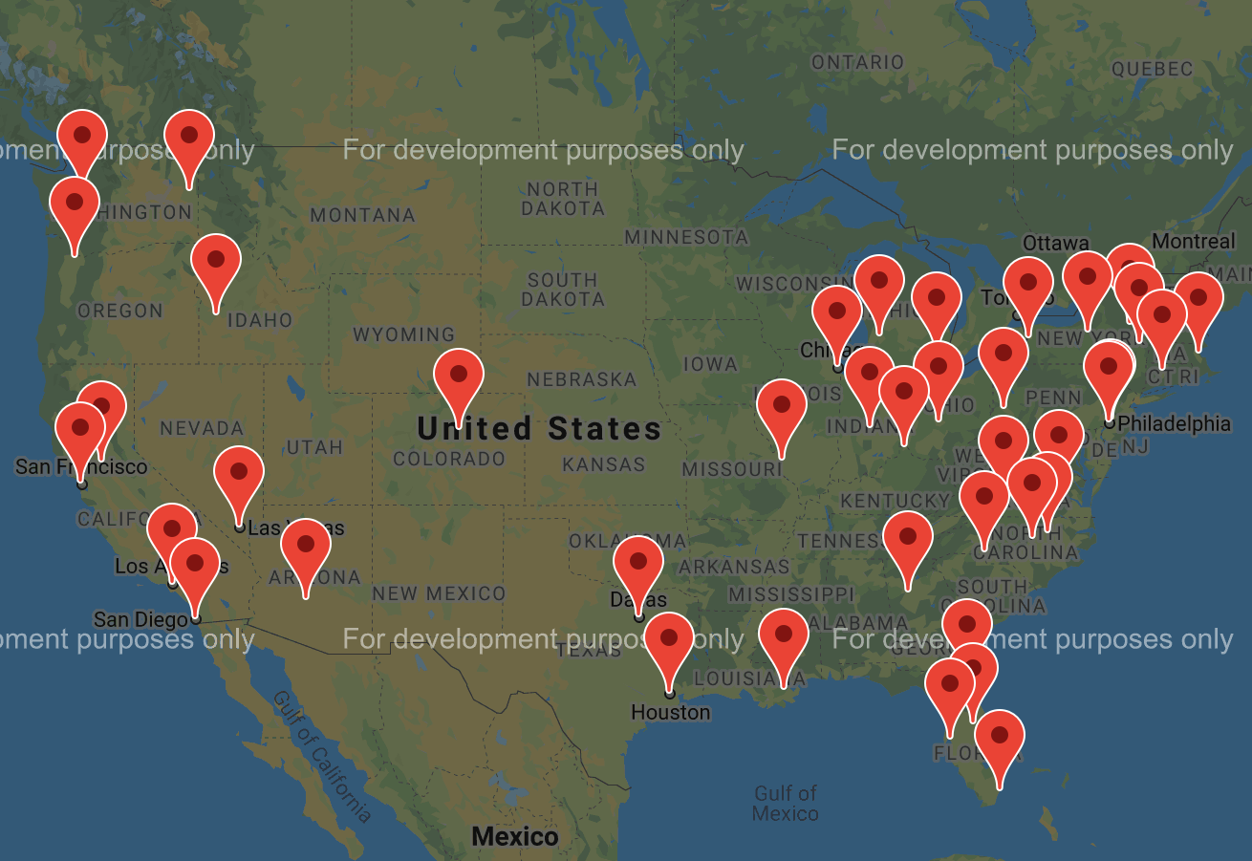
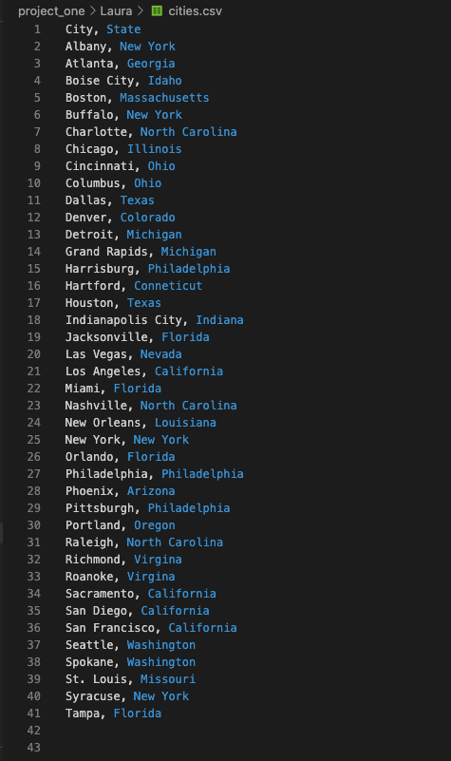
Locations of Interest
Notes:
Laura

Slide 5
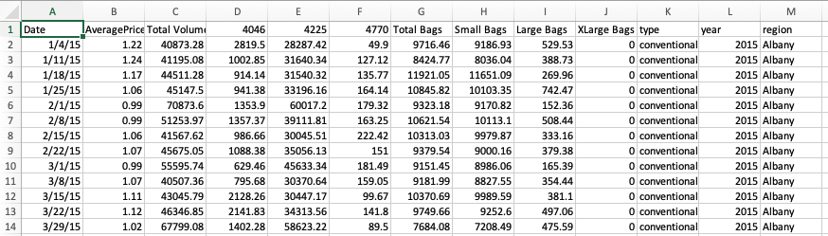
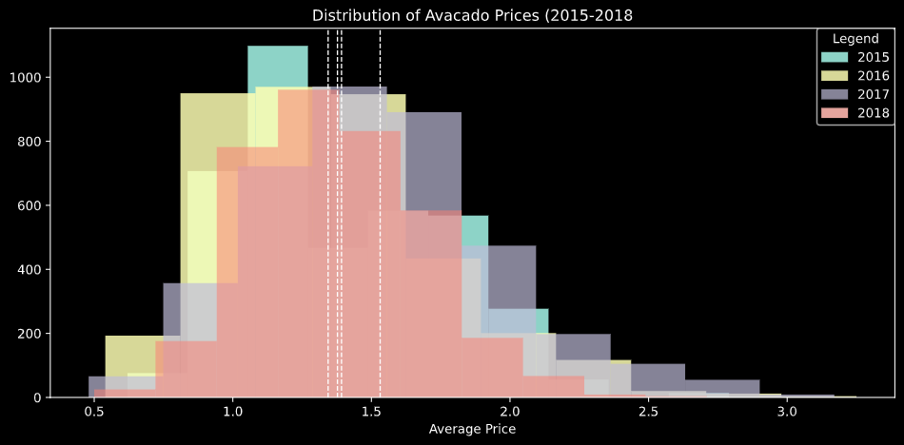
Avocado data
13 columns, 18722 Rows
Average Price
Cleaning Data
Removed excess and unrelated information.
Removed years not in the 3 main data sets.
Formatted the context ie city names to be the same across data sets.
Avocado dataset
Matplotlib
Normal Test results for 2015 are statistic=3.165418348345291 with a pvalue=0.2054178309964272)
Normal Test results for 2016 are statistic=4.917488597178161 with a pvalue=0.08554229914031346)
Normal Test results for 2017 are statistic=8.92214851212411, with a pvalue=0.011549949017861348)
Normal Test results for 2018 are statistic=1.8896928899913943, with a pvalue=0.3887392591775346)
Notes:
Adrian

Slide 6
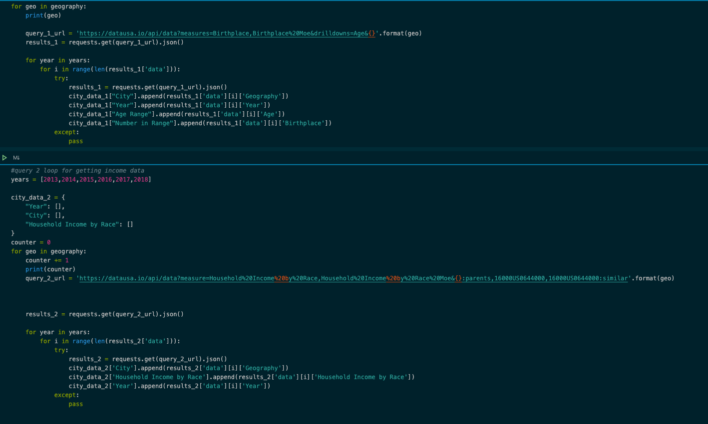
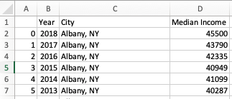
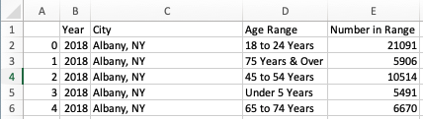
Data USA
API and JSON to pull data for the 42 cities in Avocado Dataset
2 CSV Files
Median Income
3 Columns, 1476 Rows
Population By Age Range
4 columns, 16236 Rows
Further Cleaning:
-Drop Duplicates
-Join Table for City and City, State
Median Income
Age Group
Notes:
Jeremy

Slide 7
Analysis 1: Income Vs. Average Price
Notes:
Jeremy

Slide 8
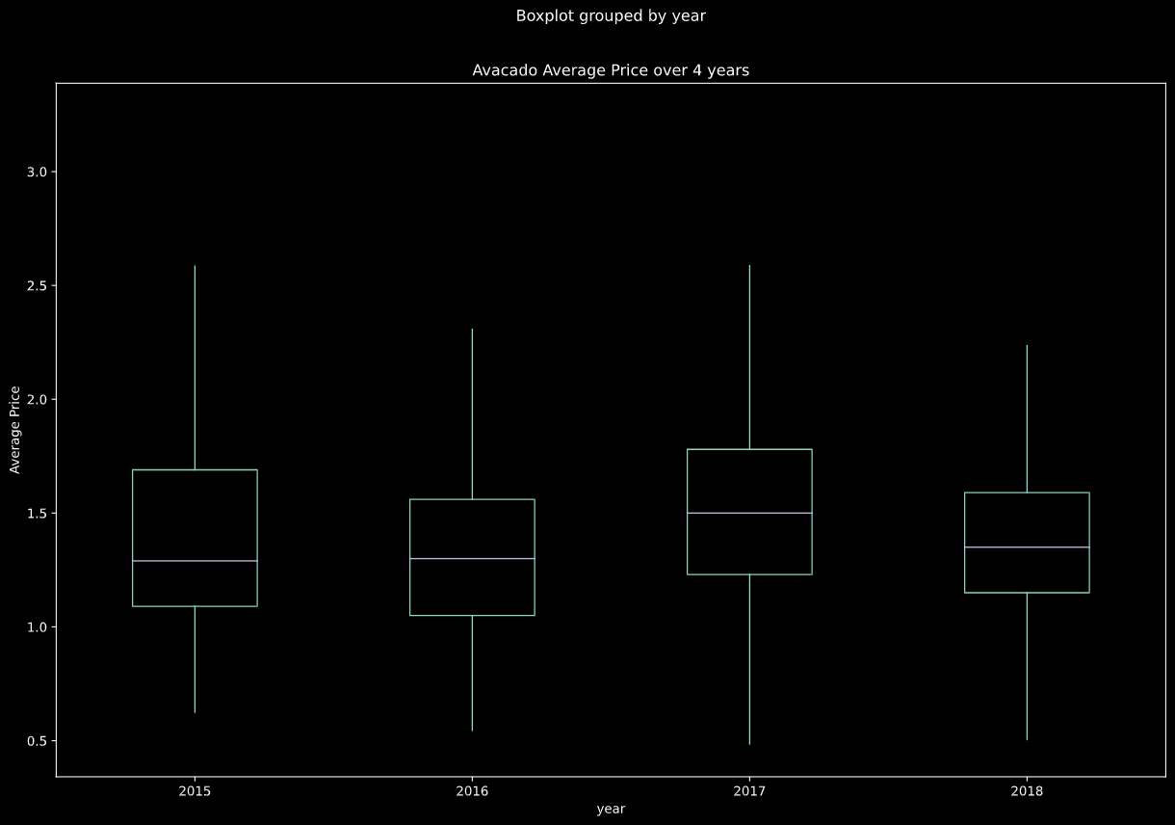
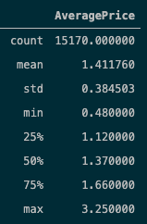
Analysis: Average Price
Avocado dataset
Pandas
Notes:
Jeremy

Slide 9
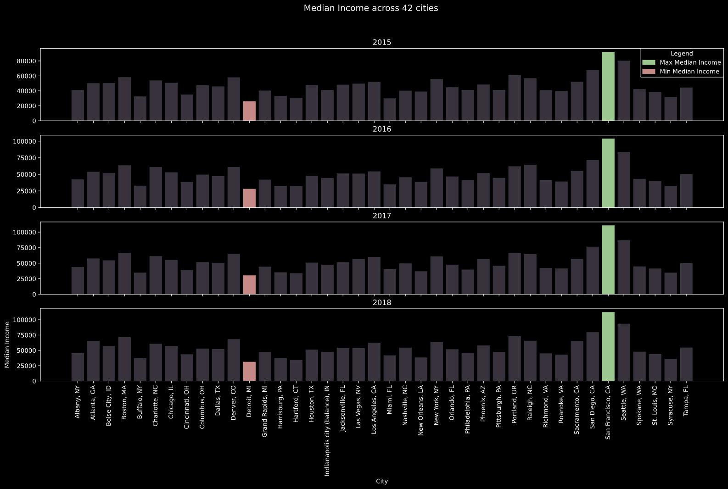
Analysis 1: Income Vs. Average Price
Median Income with Highs and Lows Highlighted
plt.subplots()
Income dataset
Matplotlib
Notes:
Jeremy

Slide 10
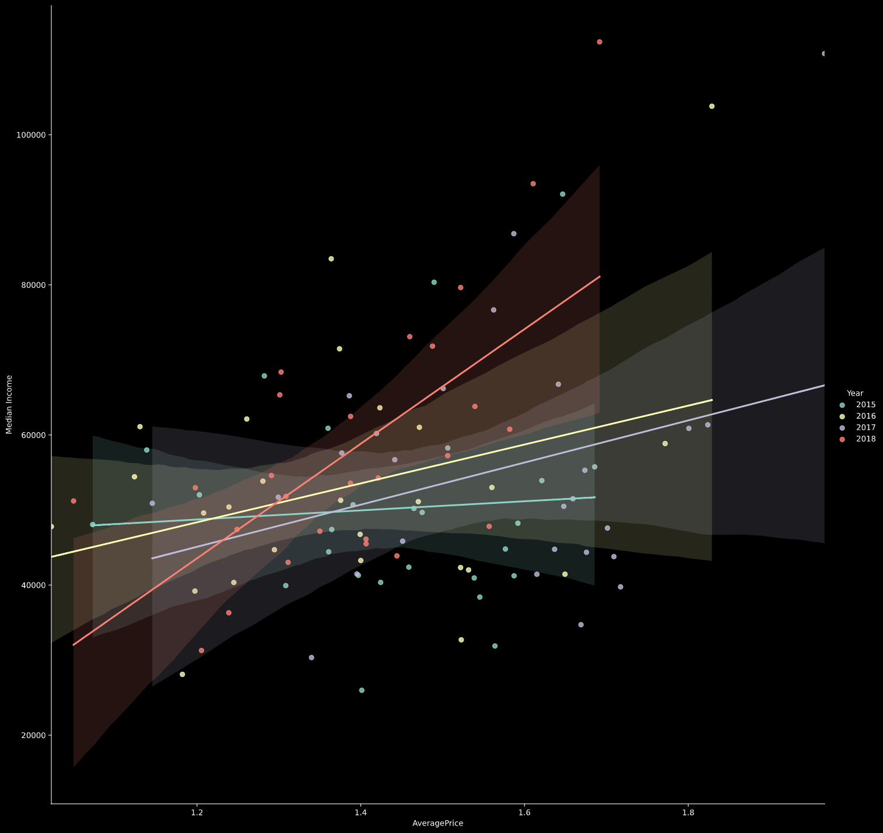
Analysis 1: Income Vs. Average Price
The line equation for 2015 is y = 6076.81x + 41442.05
The r-Squared for 2015 is 0.004458147154015406
The line equation for 2016 is y = 25900.41x + 17284.68
The r-Squared for 2016 is 0.10472518139494967
The line equation for 2017 is y = 28068.11x + 11416.46
The r-Squared for 2017 is 0.09341235056496099
The line equation for 2018 is y = 76348.44x + -48057.92
The r-Squared for 2018 is 0.4123616254754726
Avocado dataset & Median Income dataset
Seaborn
Notes:
Jeremy

Slide 11
Analysis 2: Millennial Populations
Vs. Average Price
Notes:
Jeremy

Slide 12
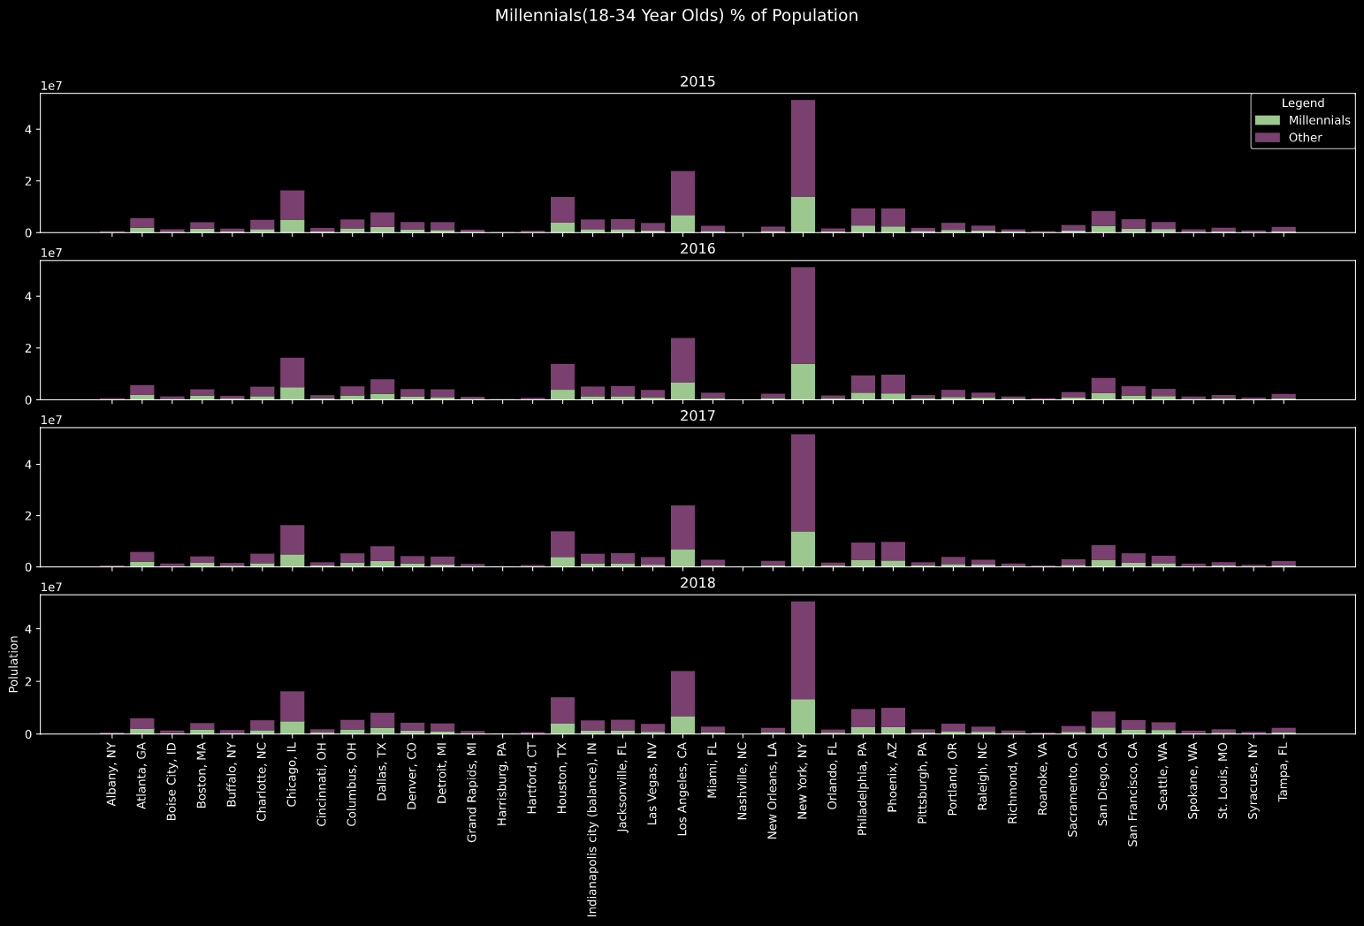
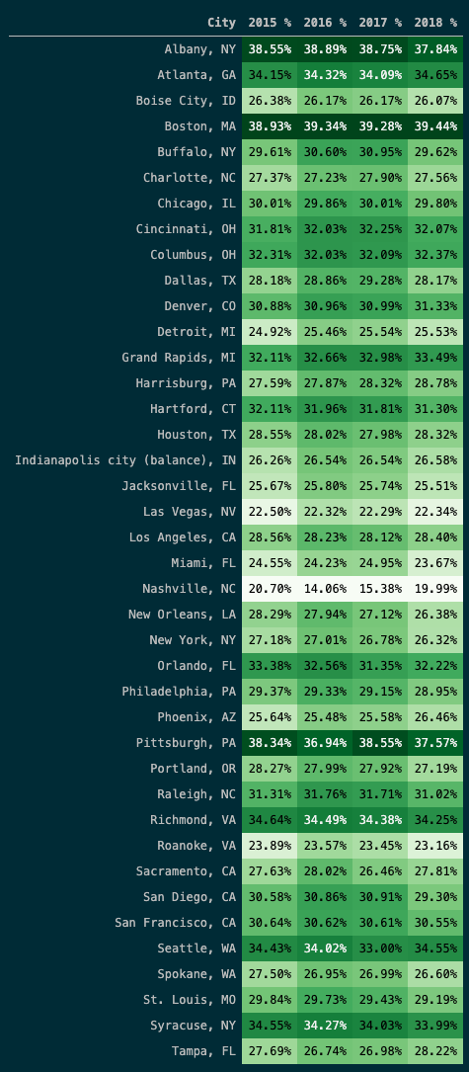
Analysis 2: Millennial Populations Vs. Average Price
Age group dataset
np.where[]
Matplotlib
Notes:
Jeremy

Slide 13
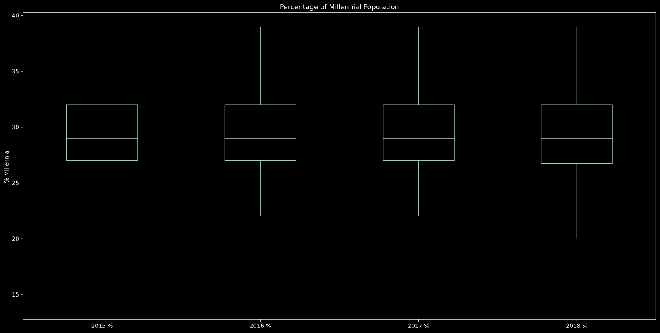
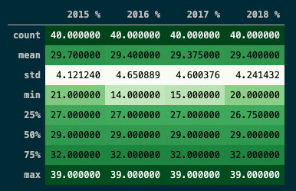
Analysis 2: Millennial Populations Vs. Average Price
Age Group dataset
Pandas
Notes:
Jeremy

Slide 14
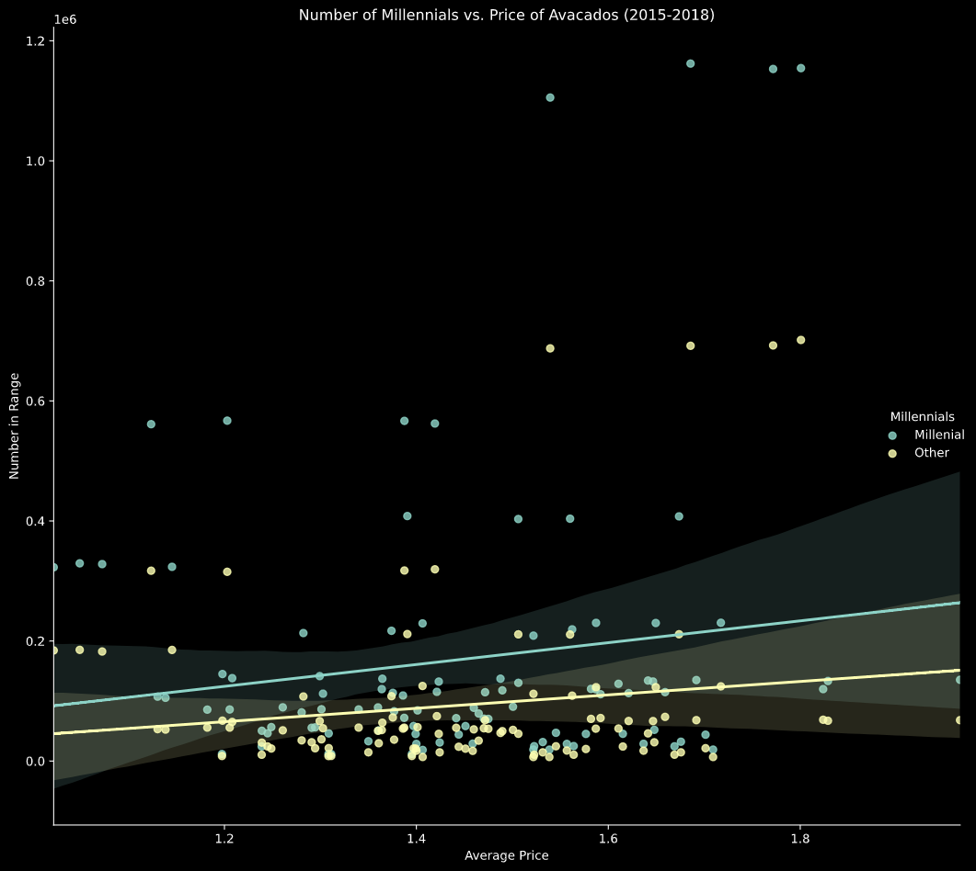
Analysis 2: Millennial Populations Vs. Average Price
The line equation for Millenial is y = 181922.13x + -93868.77
The r-Squared for Millenial is 0.021035153654571443
The line equation for Other is y = 111806.21x + -68659.15
The r-Squared for Other is 0.02217732375560323
Avocado dataset & Age Group dataset
Seaborn
Notes:
Jeremy

Slide 15
Analysis 3: Temperature
Vs. Average Price
Notes:
Adrian

Slide 16
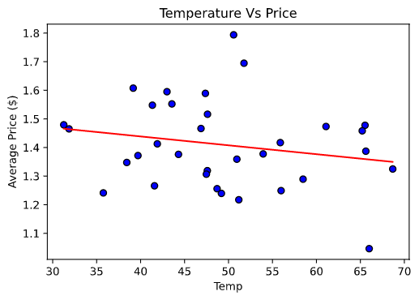
Does the weather in cities affect the price?
The line equation is y = -0.0x + 1.56
The r-Squared is 0.040818288930768776
Notes:
Adrian

Slide 17
Findings
Does the millennial population percentage affect the price of avocados?
Does the average household income affect the price of avocados?
Does the weather affect the price of avocados?
Notes:
Laura

Slide 18
Other Considerations
Distance from Harvest to purchase location
Harvest yield on any given year
Time of year and availability of Avocados
Many other factors
Notes:
Jeremy

Slide 19

Questions?
Notes:
Everyone :)

